Slide 1
Windows Server Activation models

Slide 2
Agenda
Licensing and activation
Manual activation
Automatic activation

Slide 3
Licensing and activation
If you do not activate Windows Server 2016, you cannot customize your operating system. There are two general activation strategies:
• Manual activation. This strategy is suitable when you deploy a small number of servers.
• Automatic activation. This strategy is suitable when you deploy a large number of servers.

Slide 4
Agenda
Licensing and activation
Manual activation
Automatic activation

Slide 5
Manual activation
When you use manual activation, you must enter the product key.
You can perform manual activation by using the retail product key or the multiple activation key. You can use a retail product key to activate only a single computer. However, a multiple activation key has a set number of activations that you can use. This allows you to activate multiple computers, up to a set activation limit.
OEM keys are a special type of activation key that a manufacturer receives, comes pre-installed on a PC when it is initially purchased and which enable automatic activation when a computer starts.
If that license came pre-installed on your PC, you can use that to re-install Windows on that PC any number of times

Slide 6
Agenda
Licensing and activation
Manual activation
Automatic activation

Slide 7
Automatic activation
Key Management Services (KMS).
KMS is a service that helps you activate licenses on systems within your network from a server where a KMS host has been installed. The KMS host completes the activation process instead of individual computers connecting to Microsoft to complete activation. You must setup a KMS client-server network. KMS clients are able to contact KMS servers as long as your network uses either a static TCP/IP configuration or you have a Domain Name System (DNS) server setup.
To configure KMS hosts systems, you must configure and retrieve Volume Activation information. This is done by using a Software License Manager (referred to as SL Manager) script (Slmgr.vbs). This script can be run on a local system or a remote system but it needs to be run from a user’s account that uses an elevated command prompt.

Slide 8
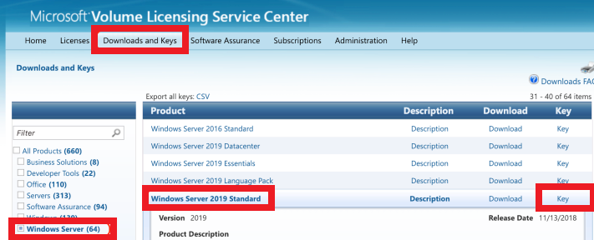
Deploying KMS Activation Host
Install Volume Activation Services role:Install-WindowsFeature -Name VolumeActivation -IncludeAllSubFeature –Include ManagementTools
If your Windows Defender Firewall with Advanced Security service is enabled, you need to open incoming connections on TCP port 1688 in order for the KMS client to contact KMS server. This can be done by the following PowerShell command:Enable-NetFirewallRule -Name SPPSVC-In-TCP
Go to the Microsoft Volume Licensing Service Center website > Downloads and Keys > Windows Server > Windows Server 2019 > Key and copy your KMS Host Key (Windows Srv 2019 DataCtr/Std KMS).
Now you can install your KMS host key on your server. Run the command:slmgr /ipk <your_Windows_SRV_2019_KMS_host_key>
In order to activate your KMS server on Microsoft servers online, run the command:slmgr /ato
(you need to temporarily provide direct Internet for your server);
To check the KMS server activation status, run:slmgr /dlv
If necessary, you can optionally install the Volume License Pack for your Office version in order to activate Office copies in the enterprise network;
Now you can configure KMS clients to activate on your KMS server.

Slide 9
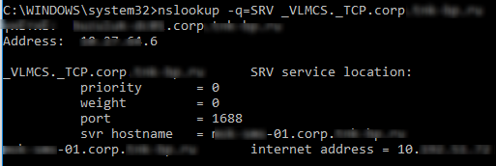
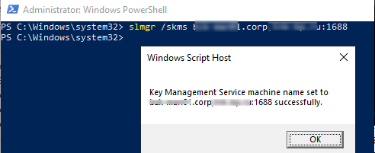
Activate Windows with KMS Server
1. Changing the activation key to the public KMS Client Setup Key
To activate a KMS client, it must have a special KMS public key installed. This product key is called the GVLK key (Generic Volume License Key). For each Windows editions, this key is unique. To replace an existing product key, run the command prompt as an administrator on the computer you are want to activate and type:
slmgr.vbs /ipk XXXXX-XXXXX-XXXXX-XXXXX-XXXXX
(XXXXX is GVLK key for your Windows edition from the table below)
2. Checking VLMCS Record in DNS and setting KMS server address
After you specify the GVLK key, the KMS client tries to connect to the previously configured KMS server or find a special SRV (_VLMCS) record in the DNS. This DNS record is created when you install a new KMS server in the domain and pointing to your KMS server. After KMS server discovery using the DNS server, the client performs the OS activation. You can skip this step if your DNS has a valid SRV record that allows clients to find the KMS server.
nslookup -q=SRV _VLMCS._TCP.theitbros.com
If the client does not find the KMS server automatically, you can specify the address of the KMS server manually using the slmgr with the option /skms. You can also specify the TCP port on which the activation service listens (by default 1688):
slmgr.vbs /skms <KMS_server_name_or_IP>:1688
You can test network connectivity between your computer and the KMS server using the PowerShell command:
Test-NetConnection -ComputerName KMS_server_name_or_IP -Port 1688

Slide 10
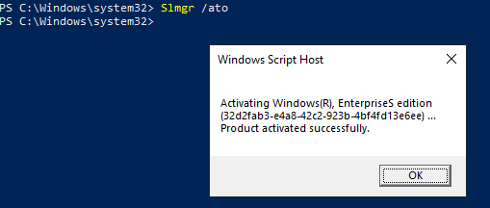
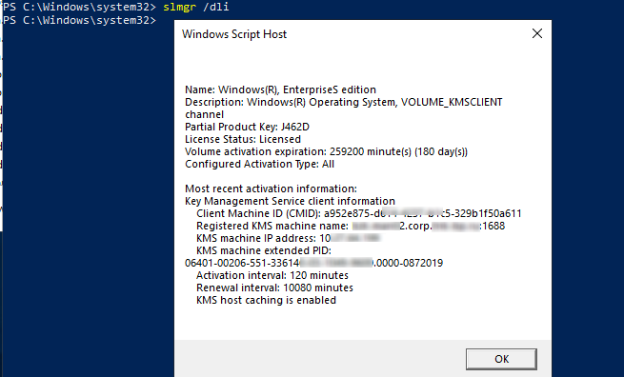
Check the Status of Windows Activation
Optionally, you can display information about the Windows activation status:
Activate Windows with KMS Server
3. To activate Windows with the KMS server, run the command:Slmgr.vbs /ato
And wait until the message Product activated successfully appear;
4. Check the Status of Windows Activation
Optionally, you can display information about the Windows activation status: slmgr.vbs /dli

Slide 11
Most Common KMS Activation Errors
Most often users facing the following errors when activating Windows with KMS server:
0xC004F074 — key management server is unavailable. It means that the KMS service on the server is not running or access to it from the client is blocked (check TCP port 1688 availability on a server);
0xC004F038 — you did not have the necessary number of activation request on the KMS server (for desktop Windows edition the minimum number of KMS clients – 25, for Windows Server – 5);
0xC004F015 — you can see this error when you try to activate Windows 10/Server 2016/2019 on an old KMS server that is activated with the old KMS host key. In this case, you need to get a new KMS host key from VLSC, and reactivate your KMS server.
Unable to reach Windows activation servers.

Slide 12
Operating system version | KMS Client License Key
Windows Server 2019
Windows Server 2019 Datacenter | WMDGN-G9PQG-XVVXX-R3X43-63DFG
Windows Server 2019 Standard | N69G4-B89J2-4G8F4-WWYCC-J464C
Windows Server 2019 Essentials | WVDHN-86M7X-466P6-VHXV7-YY726
Windows 10 LTSC 2019
Windows 10 Enterprise LTSC 2019 | M7XTQ-FN8P6-TTKYV-9D4CC-J462D
Windows 10 Enterprise N LTSC 2019 | 92NFX-8DJQP-P6BBQ-THF9C-7CG2H
Windows Server 2016
Windows Server 2016 Datacenter | CB7KF-BWN84-R7R2Y-793K2-8XDDG
Windows Server 2016 Standard | WC2BQ-8NRM3-FDDYY-2BFGV-KHKQY
Windows Server 2016 Essentials | JCKRF-N37P4-C2D82-9YXRT-4M63B
Windows 10
Windows 10 Professional | W269N-WFGWX-YVC9B-4J6C9-T83GX
Windows 10 Professional N | MH37W-N47XK-V7XM9-C7227-GCQG9
Windows 10 Enterprise | NPPR9-FWDCX-D2C8J-H872K-2YT43
Windows 10 Enterprise N | DPH2V-TTNVB-4X9Q3-TJR4H-KHJW4
Windows 10 Education | NW6C2-QMPVW-D7KKK-3GKT6-VCFB2
Windows 10 Education N | 2WH4N-8QGBV-H22JP-CT43Q-MDWWJ
Windows 10 Enterprise 2015 LTSB | WNMTR-4C88C-JK8YV-HQ7T2-76DF9
Windows 10 Enterprise 2015 LTSB N | 2F77B-TNFGY-69QQF-B8YKP-D69TJ
Windows 10 Enterprise 2016 LTSB | DCPHK-NFMTC-H88MJ-PFHPY-QJ4BJ
Windows 10 Enterprise 2016 LTSB N | QFFDN-GRT3P-VKWWX-X7T3R-8B639
Windows Server 2012 R2
Windows Server 2012 R2 Standard | D2N9P-3P6X9-2R39C-7RTCD-MDVJX
Windows Server 2012 R2 Datacenter | W3GGN-FT8W3-Y4M27-J84CP-Q3VJ9
Windows Server 2012 R2 Essentials | KNC87-3J2TX-XB4WP-VCPJV-M4FWM
Windows Public GVLK Keys

Slide 13
AVMA allows you to install virtual machines on that Windows Server operating system without the need of using or managing product keys for each virtual machine.
AVMA attaches the virtual machine activation to the properly activated Hyper-V machine during the startup process.
AVMA requires Windows Server 2016 with the Hyper-V role installed. AVMA can also run on Windows Server 2012 and Windows Server 2012 R2 if needed.
Edition | AVMA key
Datacenter | H3RNG-8C32Q-Q8FRX-6TDXV-WMBMW
Standard | TNK62-RXVTB-4P47B-2D623-4GF74
Essentials | 2CTP7-NHT64-BP62M-FV6GG-HFV28

Slide 14
Automatic Activation
AVMA allows you to install virtual machines on that Windows Server operating system without the need of using or managing product keys for each virtual machine.
AVMA attaches the virtual machine activation to the properly activated Hyper-V machine during the startup process.
AVMA requires Windows Server 2016 with the Hyper-V role installed. AVMA can also run on Windows Server 2012 and Windows Server 2012 R2 if needed.
Automatic Virtual Machine Activation (AVMA)
Edition | AVMA key
Datacenter | H3RNG-8C32Q-Q8FRX-6TDXV-WMBMW
Standard | TNK62-RXVTB-4P47B-2D623-4GF74
Essentials | 2CTP7-NHT64-BP62M-FV6GG-HFV28

Slide 15
Automatic Activation
AD-based activation

